Slide 1
Github Profile Viewer
Submitted by: Kartik Arora (2210990486) Jatin Jaglan (2210990458) Kartikey Bartwal (2210990) Jaskirat Singh Bedi (2210990)
Submitted to: Baljit Kaur Vikas Patel

Slide 2
Outline
Introduction
Overview
Key Features
Steps to use it
Live Demo
Responsive Nature
Tech Stack
Objective
References
Conclusion

Slide 3

GITHUB PROFILE VIEWER:
Unveiling the Code Canvas

Slide 4
Overview
GitHub has become the heartbeat of the coding community, hosting millions of repositories across various domains.
Introducing "GitHub Profile Viewer," a powerful tool designed to revolutionize how we interact with and explore GitHub profilesa.
The GitHub Profile Viewer is a web application designed to provide a visual representation of your coding journey on GitHub, enhancing the overall experience and facilitating effective collaboration within the community.

Slide 5
Key Features
Seamless Navigation: Effortlessly navigate through GitHub profiles with an intuitive and user-friendly interface.
Comprehensive Insights: Gain a holistic view of a developer's contributions, repositories, and collaborations.
Visual Repository Explorer: Dive into repositories through a visually engaging interface, making code exploration a delightful experience.

Slide 6
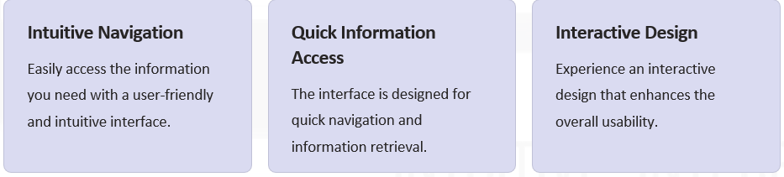
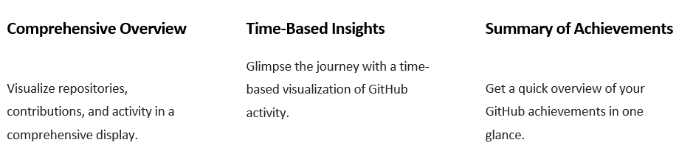
Key Features

Slide 7
How Github Profile Viewer Works
1- Head over to the deployed link.
2- Insert the username you wish to check for.
3- Click on View.
It will then redirect to a new page where data of that user will be displayed. If the username is invalid, it will be notified as undefined.

Slide 8
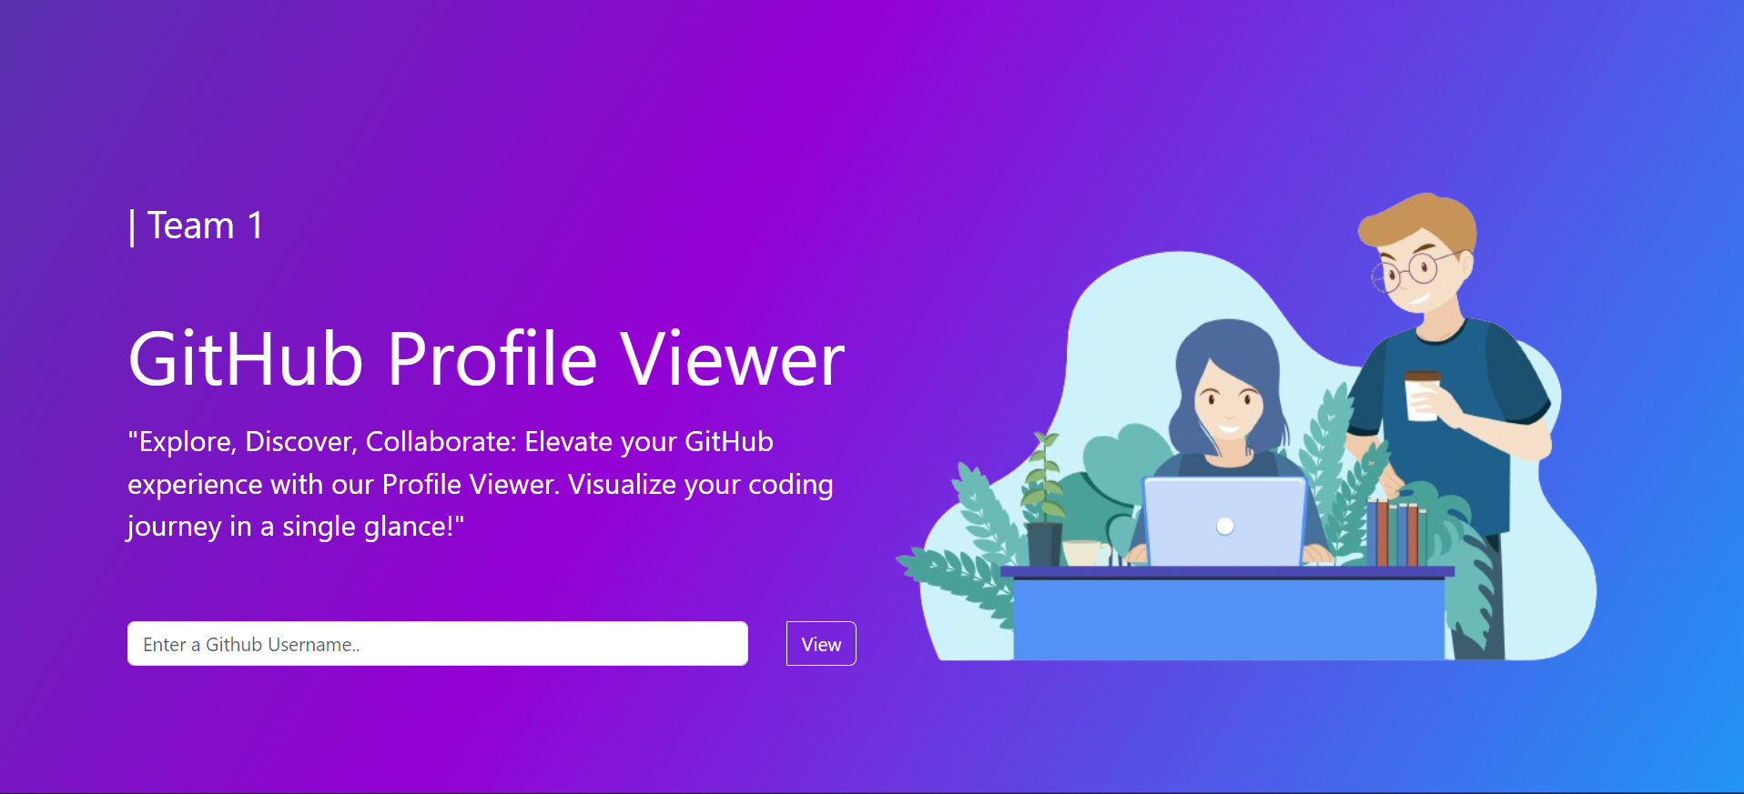
Live Demo
Home Page Person can enter the username they wish to look for in the input box.
Background: We have used a linear gradient animation for background, which looks soothing.

Slide 9
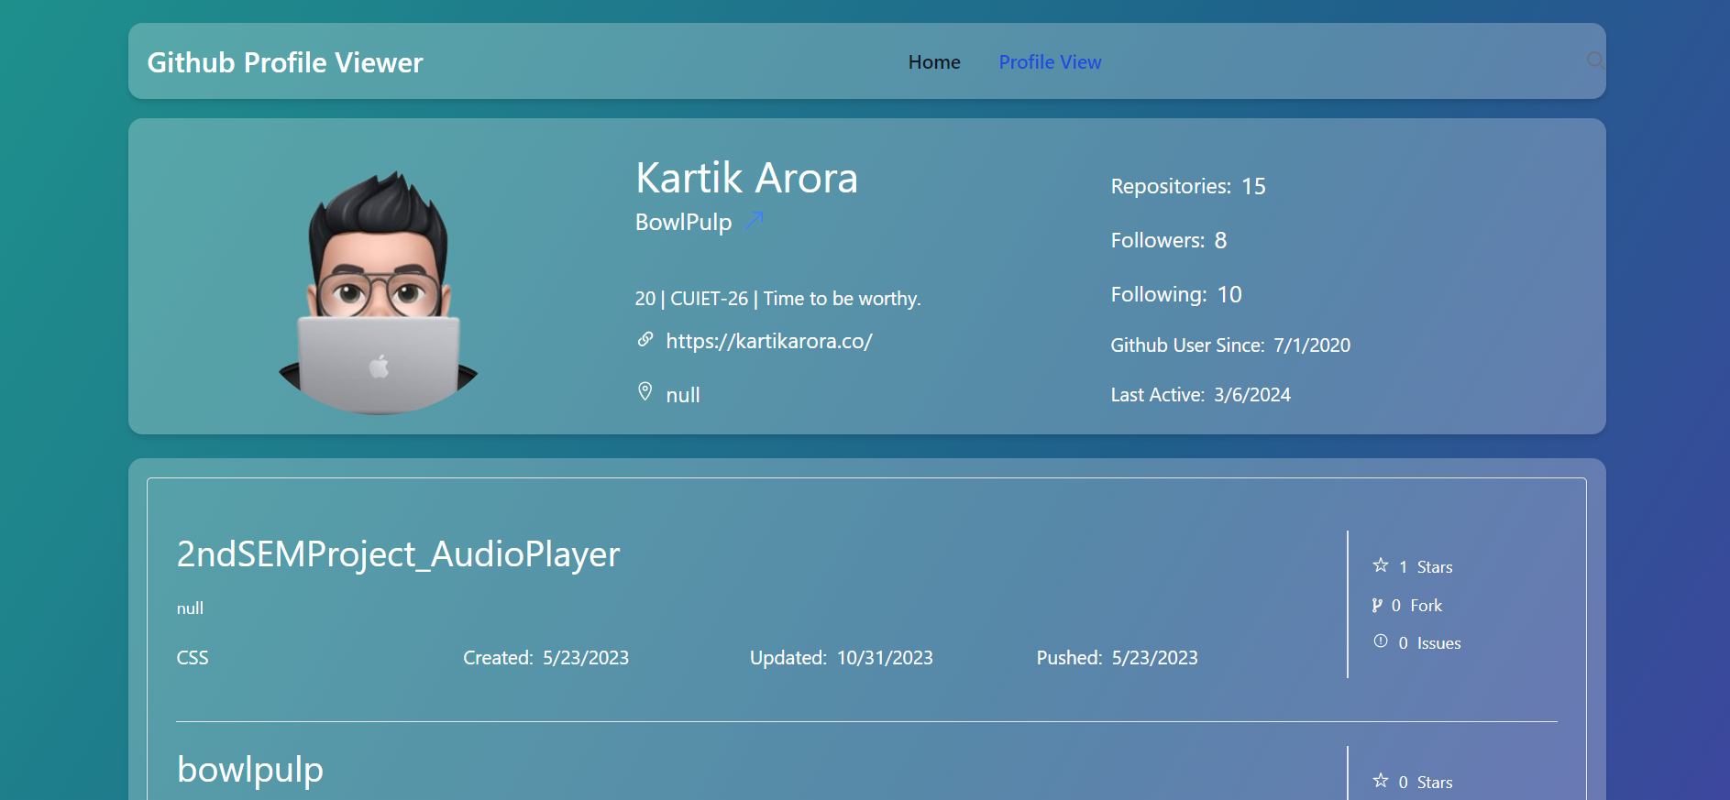
Profile Section: We have used Github’s api calling to fetch the information in a more systematic way. This allows users to view informations like - Repos, Followers, Following, Description, and every other information in their github profiles.

Slide 10
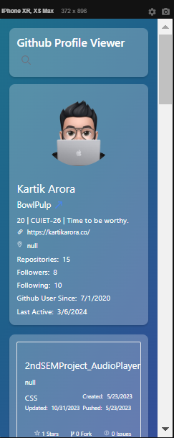
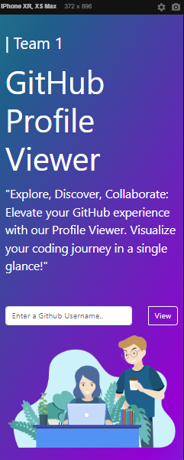
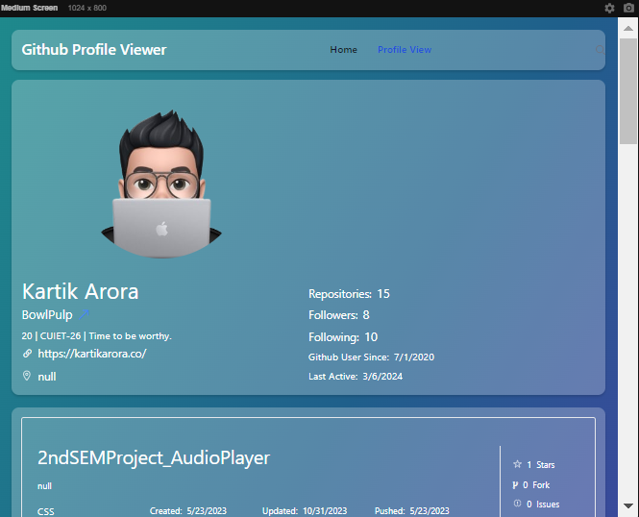
Responsive Nature
Both the Pages, are responsive in nature, that means they are set to work in phone & tab breakpoints.

Slide 11




Tech Stack
HTML
CSS
JAVASCRIPT
BOOTSTRAP
Github

Slide 12
Objective
Empowering GitHub Interaction:
The primary objective of the GitHub Explorer app is to revolutionize the way users engage with GitHub profiles, providing a seamless and enriched experience.

Slide 13
References
Bootstrap
https://getbootstrap.com/
Github
https://github.com/
Github Api
https://api.github.com/users/jatinjaglan347
https://api.github.com/users/jatinjaglan347/repos
3) FontAwesome
https://fontawesome.com/icons

Slide 14
Conclusion
GitHub Profile Viewer is not just a tool; it's a window into the vibrant world of coding on GitHub.
Empower your GitHub journey with GitHub Explorer, your passport to the Code Canvas!
Thank you for joining us today as we embark on this exciting exploration of GitHub Explorer. Let's unlock the full potential of GitHub profiles together!

Slide 15
Thank You

